Slide 1


Slide 2

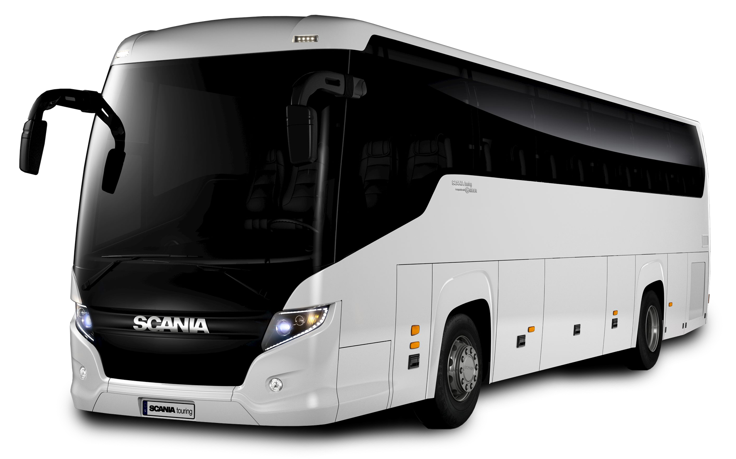
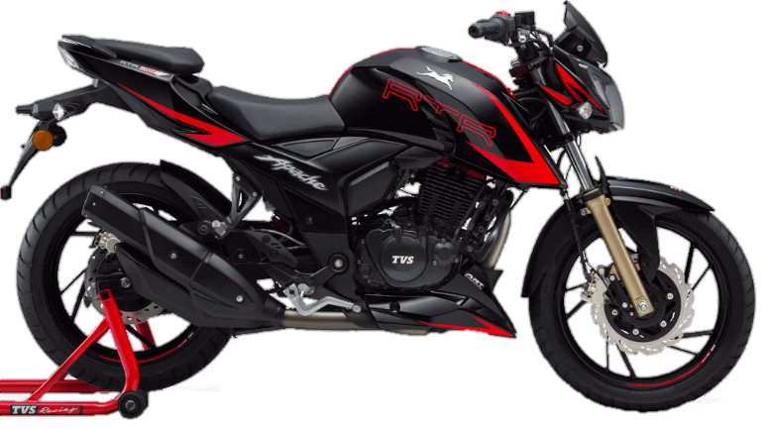
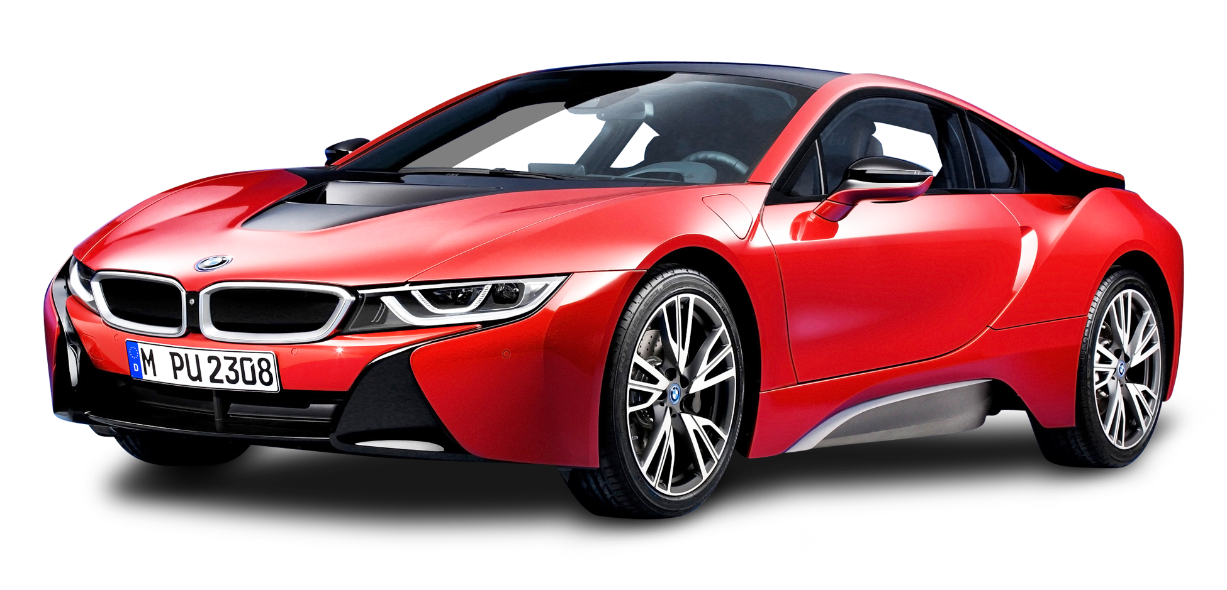
Training on Motor Insurance

Slide 3

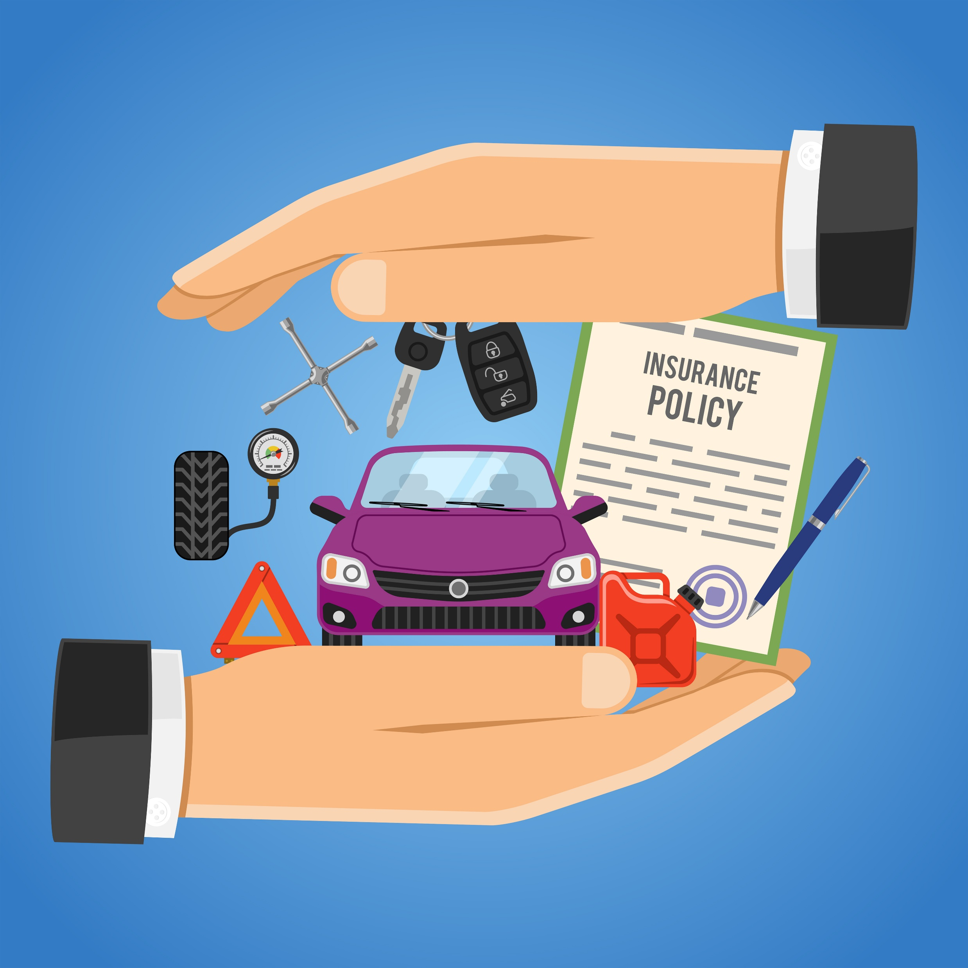
Motor Insurance
Motor insurance is the insurance for cars, buses, trucks, motorcycles & others vehicles.
It’s provides financial protection against physical damage of the vehicles as well as any others party property damages, injuries / death that can also from accident by the insured vehicle.
Motor insurance also covers financial protection against theft of the vehicles and natural disaster.

Slide 4
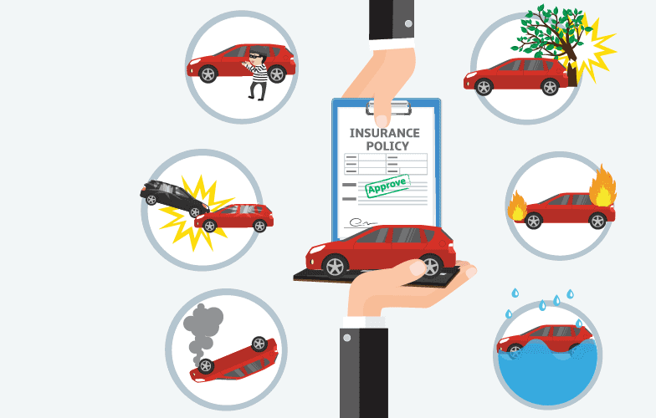
Why Needs Motor Insurance?!
To avoid financial loss due to accident
To get peace of mind against Risk (Like as Theft)
Covers any others Party Property Damages, Injuries/Death
Legal Liability
To avoid burden of loss
To get financial security

Slide 5
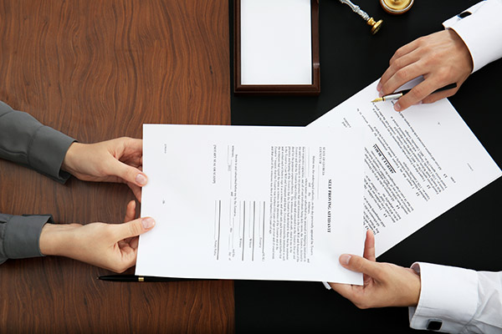
Document Required for Comprehensive Motor Insurance
Motor Insurance Proposal Form
Sum Insured value (Vehicle Purchase Invoice)
Present Market value of Vehicle (If not available Vehicle purchase Invoice)
Vehicle Registration Copy
Vehicle Owner NID
CC (cubic centimeters) of car
Seating Capacity
Vehicle Manufacturing Company Name & Year of Manufacturing
KYC form

Slide 6

Major Types of Motor Insurance
Private Vehicle (Car Insurance)
Two Wheeler (Motor Bike)
Commercial Vehicle

Slide 7

Comprehensive Motor Insurance Policies
Own Damage
Act Liabilities

Slide 8
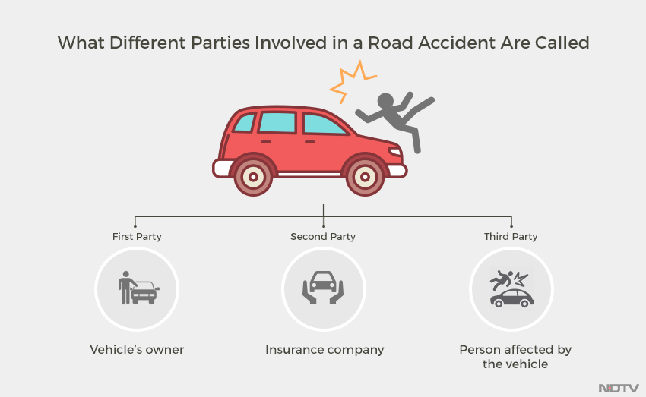
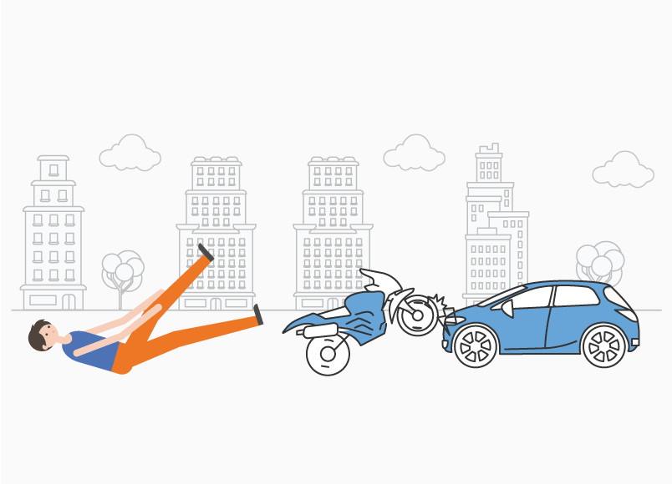
Act Liability Insurance
Another name for the Liability Only cover is "Act Only cover".
Liability Only Policy covers any legal liability you may face that occurs out of damage or loss to a others only - including death, injury, and/or property damage in the event of an accident that involves your insured vehicle.

Slide 9
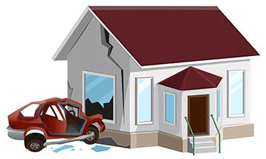
Act Liability Policy (What it Covers):
Death | Tk. 20,000/=
Severe Hurt | Tk. 10,000/=
Any Others Hurt | Tk. 5,000/=
Property Damage | Tk. 50,000/=

Slide 10

Comprehensive (Own Damage) Motor Insurance
As mentioned above, comprehensive car insurance is a combination of act liability insurance and own damage insurance.
This car policy provides comprehensive coverage against act liabilities and loss or damages caused to the insured car due to accidents, vandalism, fire, theft, manmade and natural disasters.

Slide 11
Comprehensive (Own Damage) Motor Insurance Covered
By fire explosion, self-ignition or lighting
By burglary housebreaking or theft
By Riot and Strike including malicious & terrorism activities
By Earthquake (Fire & Shock damage)
By Flood, Typhoon, Hurricane, Storm, tempest, inundation, cyclone, hailstorm, frost.
By accidental external means
Whilst in transit by road, rail, inland waterway, lift, elevator or air.
Notes:
Flood= বন্যা, Typhoon= ঘূর্ণিঝড়, Hurricane= প্রবল সামুদ্রিক ঝড়, Storm= ঝড়, tempest=প্রবল ঝড়, inundation= প্লাবন, cyclone= ঘূর্ণিঝড়, hailstorm= শিলাবৃষ্টি, frost= তুষারপাত

Slide 12
Premium Calculation (Tariff rate for Comprehensive-Four Wheelers-Private)
CC Range (cubic centimeters) | Basic Rate in BDT | Act Liabilities Rate in BDT
Up to 1300 / Up to ½ Ton | 2,795/= | 150/=
1301 to 1800 / ½ to 1 Ton | 2,873/= | 250/=
1801 to 3000 / Up to 3 Ton | 2,925/= | 350/=
3001 to above/ Above 3 Ton | 2,990/= | 450/=
Premium= {Net premium of Act Liabilities depend of CC + Basic own damage premium depend on CC + (Sum Insured Value of vehicle × 2.65%)} + 15% vat.
** Driver rate………. BDT 30/=
** Per passenger……..BDT 45/=

Slide 13
Premium Calculation (Tariff rate for Comprehensive-Four Wheelers-Private)
Perils | Rates
Fire | 0.50%
Theft | 0.50%
Earthquake | 0.25%
Flood & Cyclone | 0.25%
Riot and Strike | 0.50%
Others | 0.65%
Total | 2.65%

Slide 14
Premium Calculation (Tariff rate for Comprehensive-Two Wheelers)
CC Range (cubic centimeters) | Basic Rate in BDT | Act Liabilities Rate in BDT
Up to 150 | 200/= | 100/=
151-250 | 275/= | 130/=
251-350 (above) | 350/= | 160/=
Premium= {Net premium of Act Liabilities depend of CC + Basic own damage premium depend on CC + (Value of vehicle × 2.15%)} + 15% vat.
** Rider rate………. BDT 50/=
** passenger……..BDT 45/=

Slide 15
Premium Calculation (Tariff rate for Comprehensive-Two Wheelers)
Perils | Rates
Fire and Theft | 1.0%
Riot and Strike | 0.50%
Flood & Cyclone | 0.25%
Earthquake | 0.25%
Others | 0.15%
Total | 2.15%

Slide 16
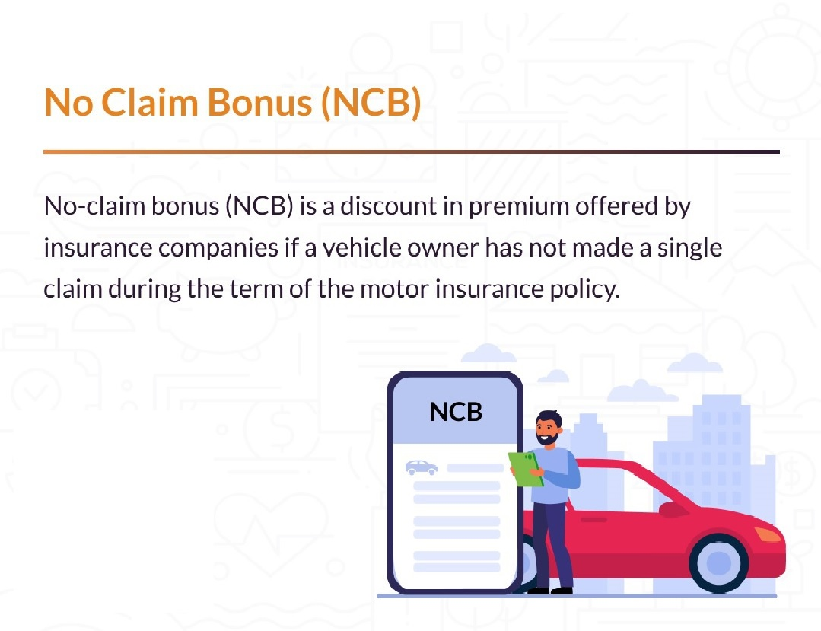
NCB (No Claim Bonus-Comprehensive)
A rebate in accordance with the following scale may be allowed by way of deduction from the premium required for the next renewal. No Claim Bonus applicable to own damage premium only.

Slide 17
NCB Process (Comprehensive)
On Comprehensive Policy | Private Vehicle | Commercial Vehicle | Motor Cycle
1st. Year. No claim made during the preceding year of insurance | 30% | 30% | 15%
2nd Year. No claim made during the preceding 2 consecutive years of insurance | 40% | 40% | 20%
3rd. Year. No claim made during the preceding 3 consecutive years of insurance | 50% | 50% | 25%

Slide 18
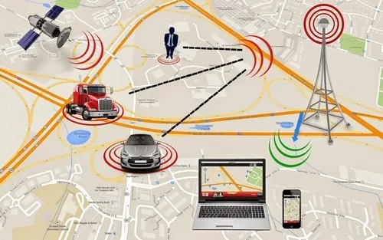
Automatic Vehicle Location System(AVLS) / Flood, Cyclone & Earthquake Deductible
10% Discount will be applicable on Own Damage Premium.
0.50 % will be deductible for exclusion of own damage Premium
Perils | Rates
Fire | 0.50%
Theft | 0.50%
Earthquake | 0.0%
Flood & Cyclone | 0.0%
Riot and Strike | 0.50%
Others | 0.65%
Total | 2.15%
Notes:
An Automatic Vehicle Location (AVL) system uses technology to track the real-time location and movement of vehicles, often using GPS or similar satellite navigation systems. It transmits this data to a central command center, enabling real-time monitoring and optimization of vehicle operations. AVL systems are widely used by organizations that manage fleets of vehicles or personnel, such as public safety agencies, transportation companies, and energy companies.

Slide 19
Claim Loading for Private Vehicle & Commercial Vehicle (Own Damage Section Only):
Own Damage Section | Private Vehicle | Commercial Vehicle
One claim in preceding period of Insurance | 30% | 30%
Two claims in preceding period of Insurance | 40% | 40%
Three claims in preceding period of Insurance | 50% | 50%

Slide 20
General Exclusion for Motor Insurance
The insurer shall not be liable under this policy in respect of –
Any accident, loss/damage and/or liability incurred outside the Geographical area,
Any claim arising out of any contractual liability.
Any loss damage which arise out for violating of the Limit to as use.
Being driven by any person other than driver as stated in the policy schedule. .
Any damage or loss due to nuclear weapons, war, Invasion, the act of foreign enemy, hostilities, or warlike activity ( whether declare or not), civil war, Mutiny, Rebellion, Military or usurp directly or indirectly.
Any loss or damage arising from ionizing radiation or contamination.
Terrorists Activity ( As per Circular).

Slide 21
Basic Terms & Condition:
Period of Insurance is for one year (01) from the date to be advised.
No Claim Bonus provides to the Insured for non claim for his/her Insured Vehicle in the previous year of Insurance.
If insured made any claim during his or her the preceding period of Insurance. Then loading is given on the Total Basic Premium to the Insured Vehicle.
If Insured entitles the N.C.B, then one loading means two steps backwards of given N.C.B.
All Motor Vehicle Act will be enforced as per Motor Vehicle Act, 2018.

Slide 22
Case Study:01
Mr. Tom Cruise wants to bring his private vehicle under Motor insurance Coverage. Here is the information about his car-
Model : Year 2020
Value : 25,00,000/-
CC : 1500.
Seating Capacity : 05 (Including Driver)
And he wants to bring his vehicle under the cover of Comprehensive Motor Insurance in 2021 & he took first time take this coverage.

Slide 23
Case Study:02
Mr. Tom Cruise wants to bring his private vehicle under Motor insurance Coverage. Here is the information about his car-
Model : Year 2020
Value : 25,00,000/-
CC : 1500.
Seating Capacity : 05 (Including Driver)
And he wants to bring his vehicle under the cover of Comprehensive Motor Insurance in 2022 & he took first time take this coverage 2021 & no claim that year.

Slide 24
Case Study:03
Mr. Tom Cruise wants to bring his private vehicle under Motor insurance Coverage. Here is the information about his car-
Model : Year 2020
Value : 25,00,000/-
CC : 1500.
Seating Capacity : 05 (Including Driver)
And he wants to Continue his vehicle under the cover of Comprehensive Motor Insurance in 2023 & he took first time take this coverage 2021 & no claim that last two years.

Slide 25
Case Study:04
Mr. David Bekham wants to bring his new private vehicle under Motor insurance Coverage. Here is the information about his car-
Model : Year 2021
Value : 35,00,000/-
CC : 2000.
Seating Capacity : 05 (Including Driver)
And he wants to his vehicle under the cover of Comprehensive Motor Insurance in 2023 & he took first time take this coverage. He Installed AVLS in this vehicle.

Slide 26
Case Study:05
Mr. Tom Cruise wants to bring his private vehicle under Motor insurance Coverage. Here is the information about his car-
Model : Year 2020
Value : 25,00,000/-
CC : 1500.
Seating Capacity : 05 (Including Driver)
And he wants to bring his vehicle under the cover of Comprehensive Motor Insurance in 2021 & he took first time take this coverage WITHOUT Flood, Cyclone & Earthquake

Slide 28

Cause of Claims
Road Accident
Theft
Natural Disaster
Fire
Flood
Earthquake

Slide 29
Motor Insurance Claims

Slide 30
Claims Procedure
Immediate Inform to PIL about the Situation
Send the original Document of Policy
Verifying the Documents
Surveyor Appointment (If the Claims Value more that BDT 5,000/-
Accept / Reject the Claims
Disburse the Claims

Slide 31
Claims Procedure
Immediate Inform
By e-mail
Time Limit: Within 24 Hours

Slide 32
Claims Procedure (Document)
Claims Form duly filled & Signed by the insured & concern Bank
Registration Certificate
Fitness Certificate
Driver’s statement
Tax Token
Driver’s Statement & Driven license.
G.D. Entry to the Police Station.
FIR to the Police in case of theft.
Police Final Investigation Report duly certified by the Court in case of theft.
Survey Report (Original).
03 (Three) repair estimates

Slide 33
Claims Settlement Way
Repair
Sum insured Value, If Total Loss

